Slide 1



Connect(); 2018 Xamarin Announcements
http://teknolot.com
Yiğit Özaksüt
yigit@ozaksut.com
www.ozaksut.com

Slide 2

Agenda
Cross-Platform UI – 3.4
Early Preview: Xamarin.Forms 4.0
https://docs.microsoft.com/en-us/xamarin/xamarin-forms/release-notes/4.0/4.0.0-pre1

Slide 3
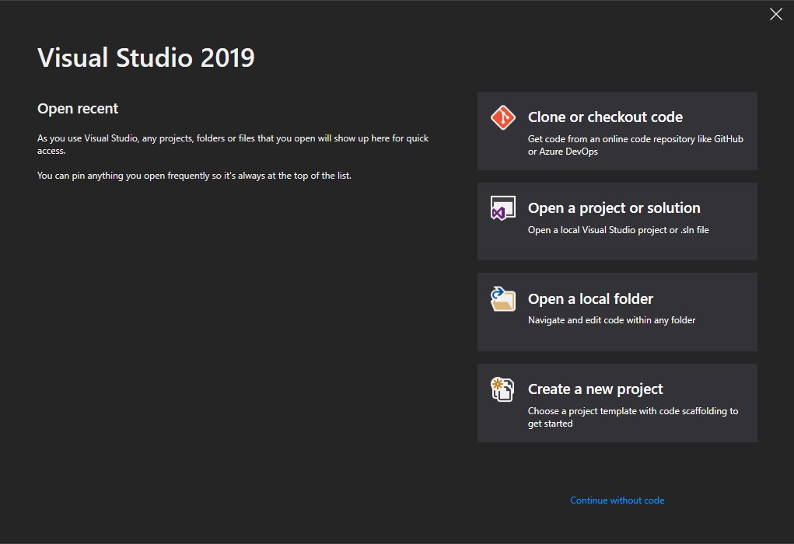
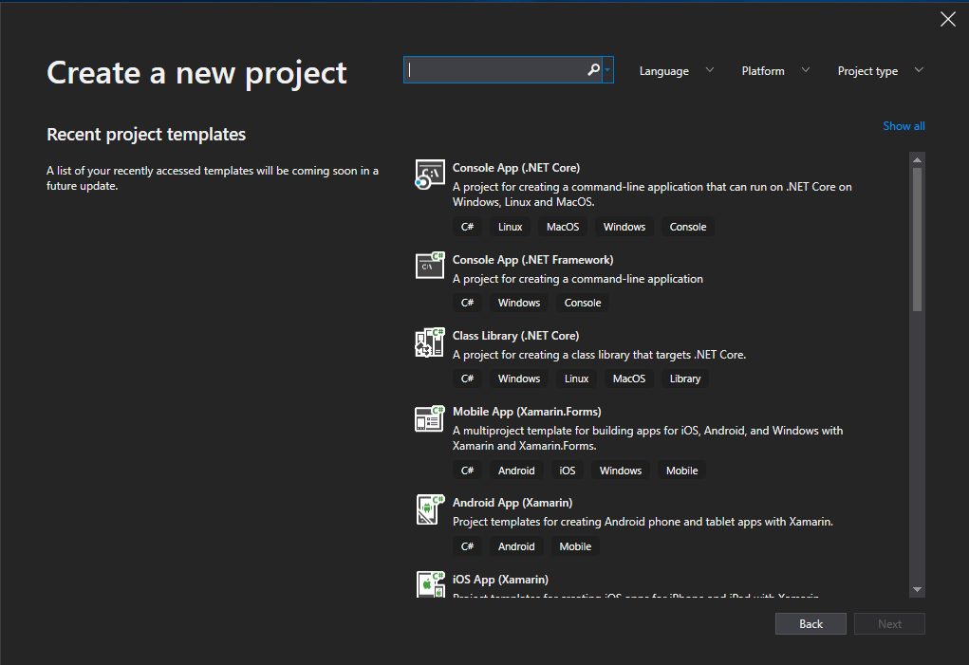
Visual Studio 19
https://visualstudio.microsoft.com/vs/preview/

Slide 4
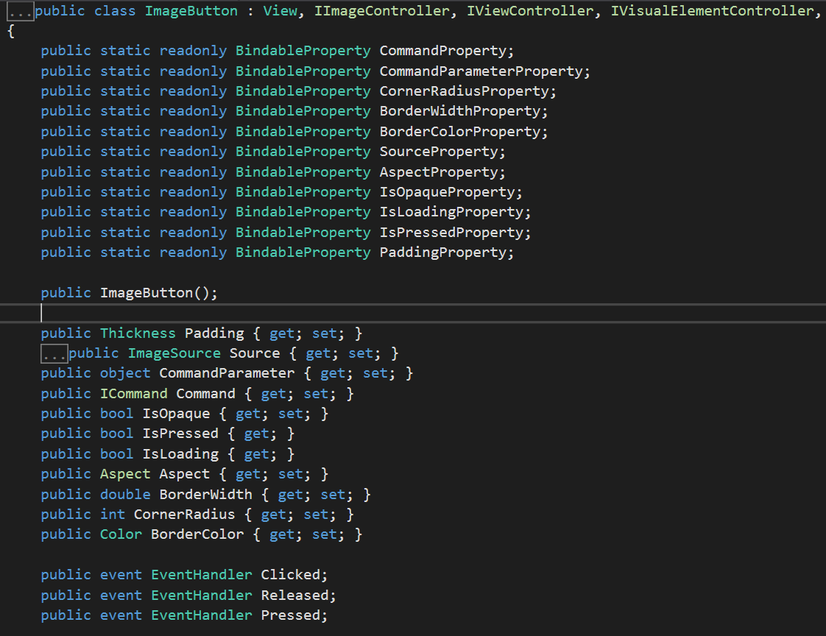
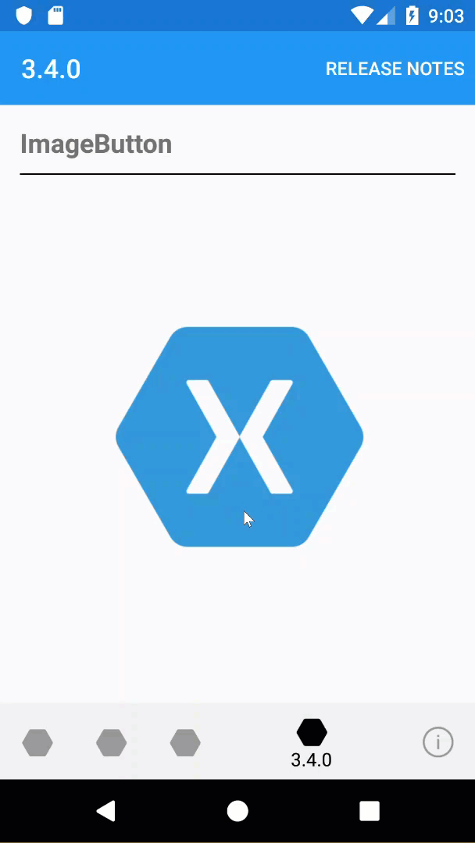
ImageButton

Slide 5

Shell – A Better Host for your Mobile App
Shell Template
Forms.SetFlags("Shell_Experimental");
New Structure
New Navigation Architecture
URI Support!
Tailwind Traders (GitHub)
Gastropods Shell (GitHub)
Shell Gallery (GitHub)
Team Builder CollectionView (GitHub)
https://aka.ms/xf-shell-templates

Slide 6
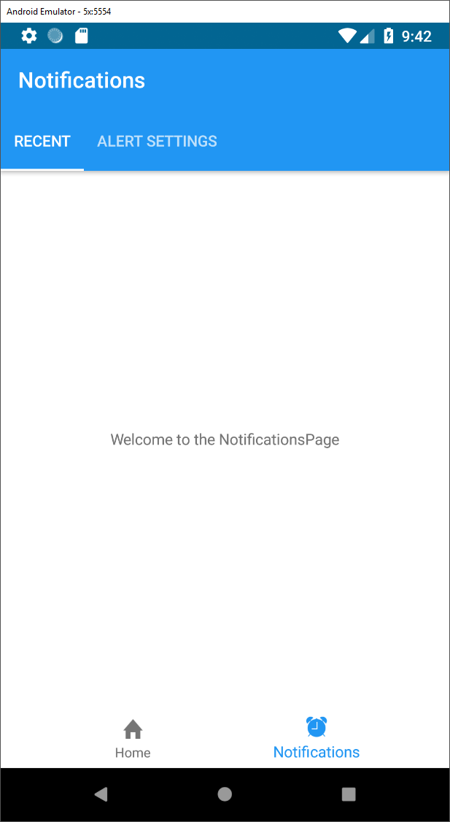
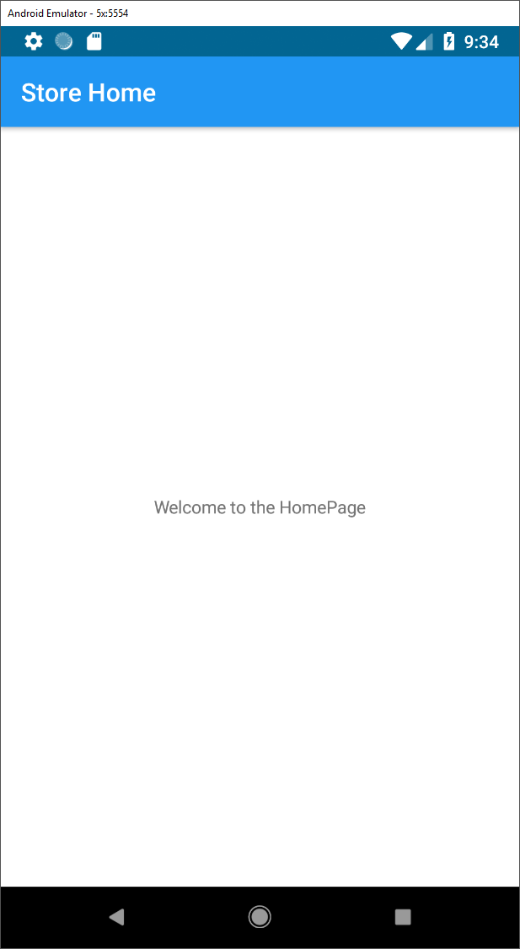
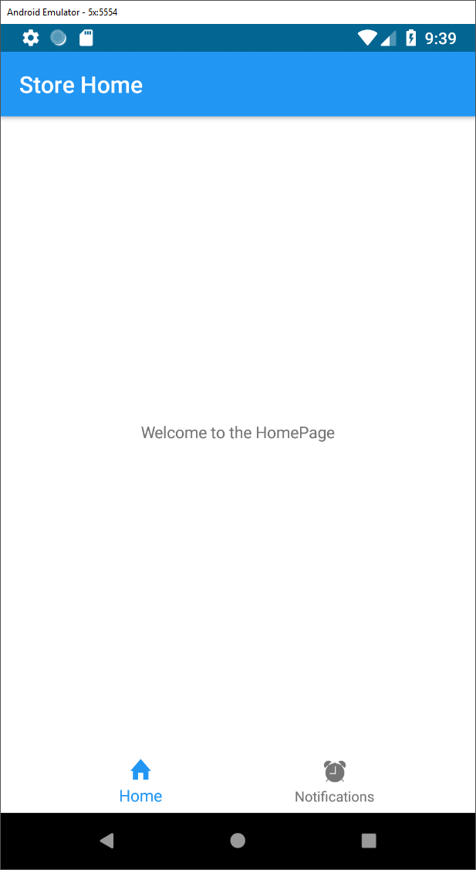
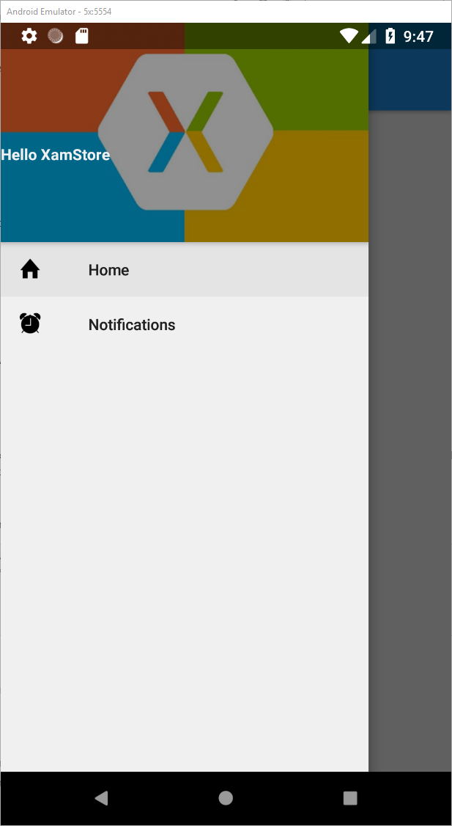
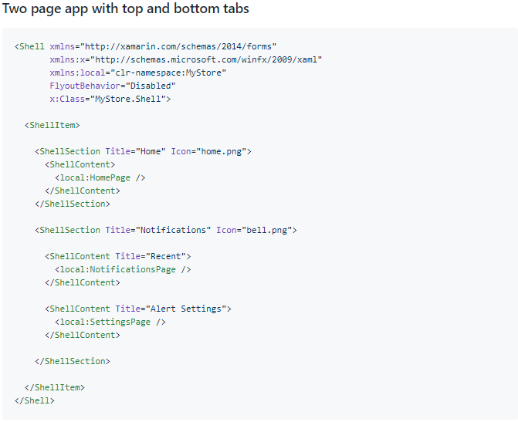
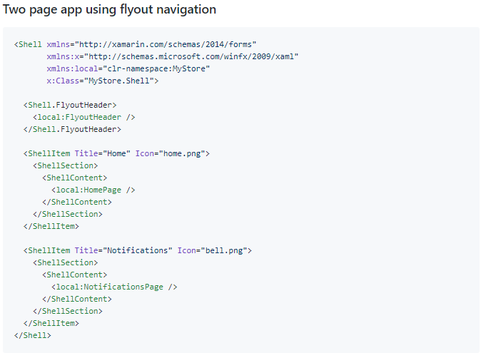
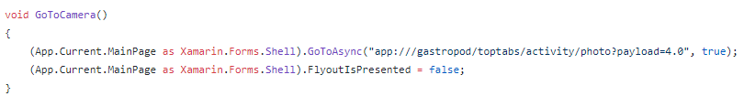
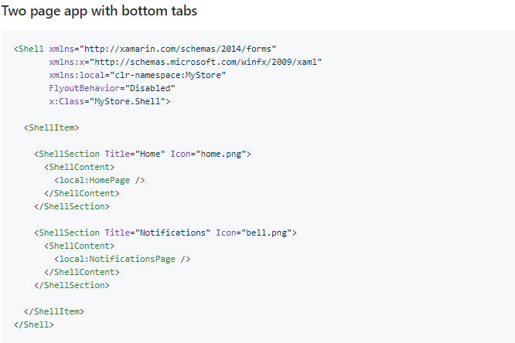
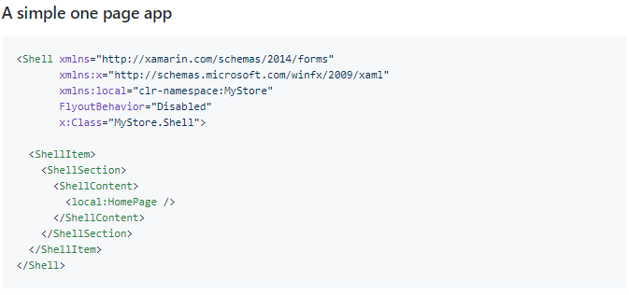
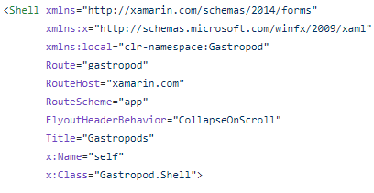
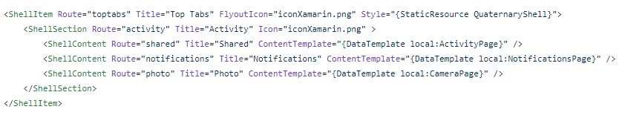
Shell – A Better Host for your
Mobile App

Slide 7
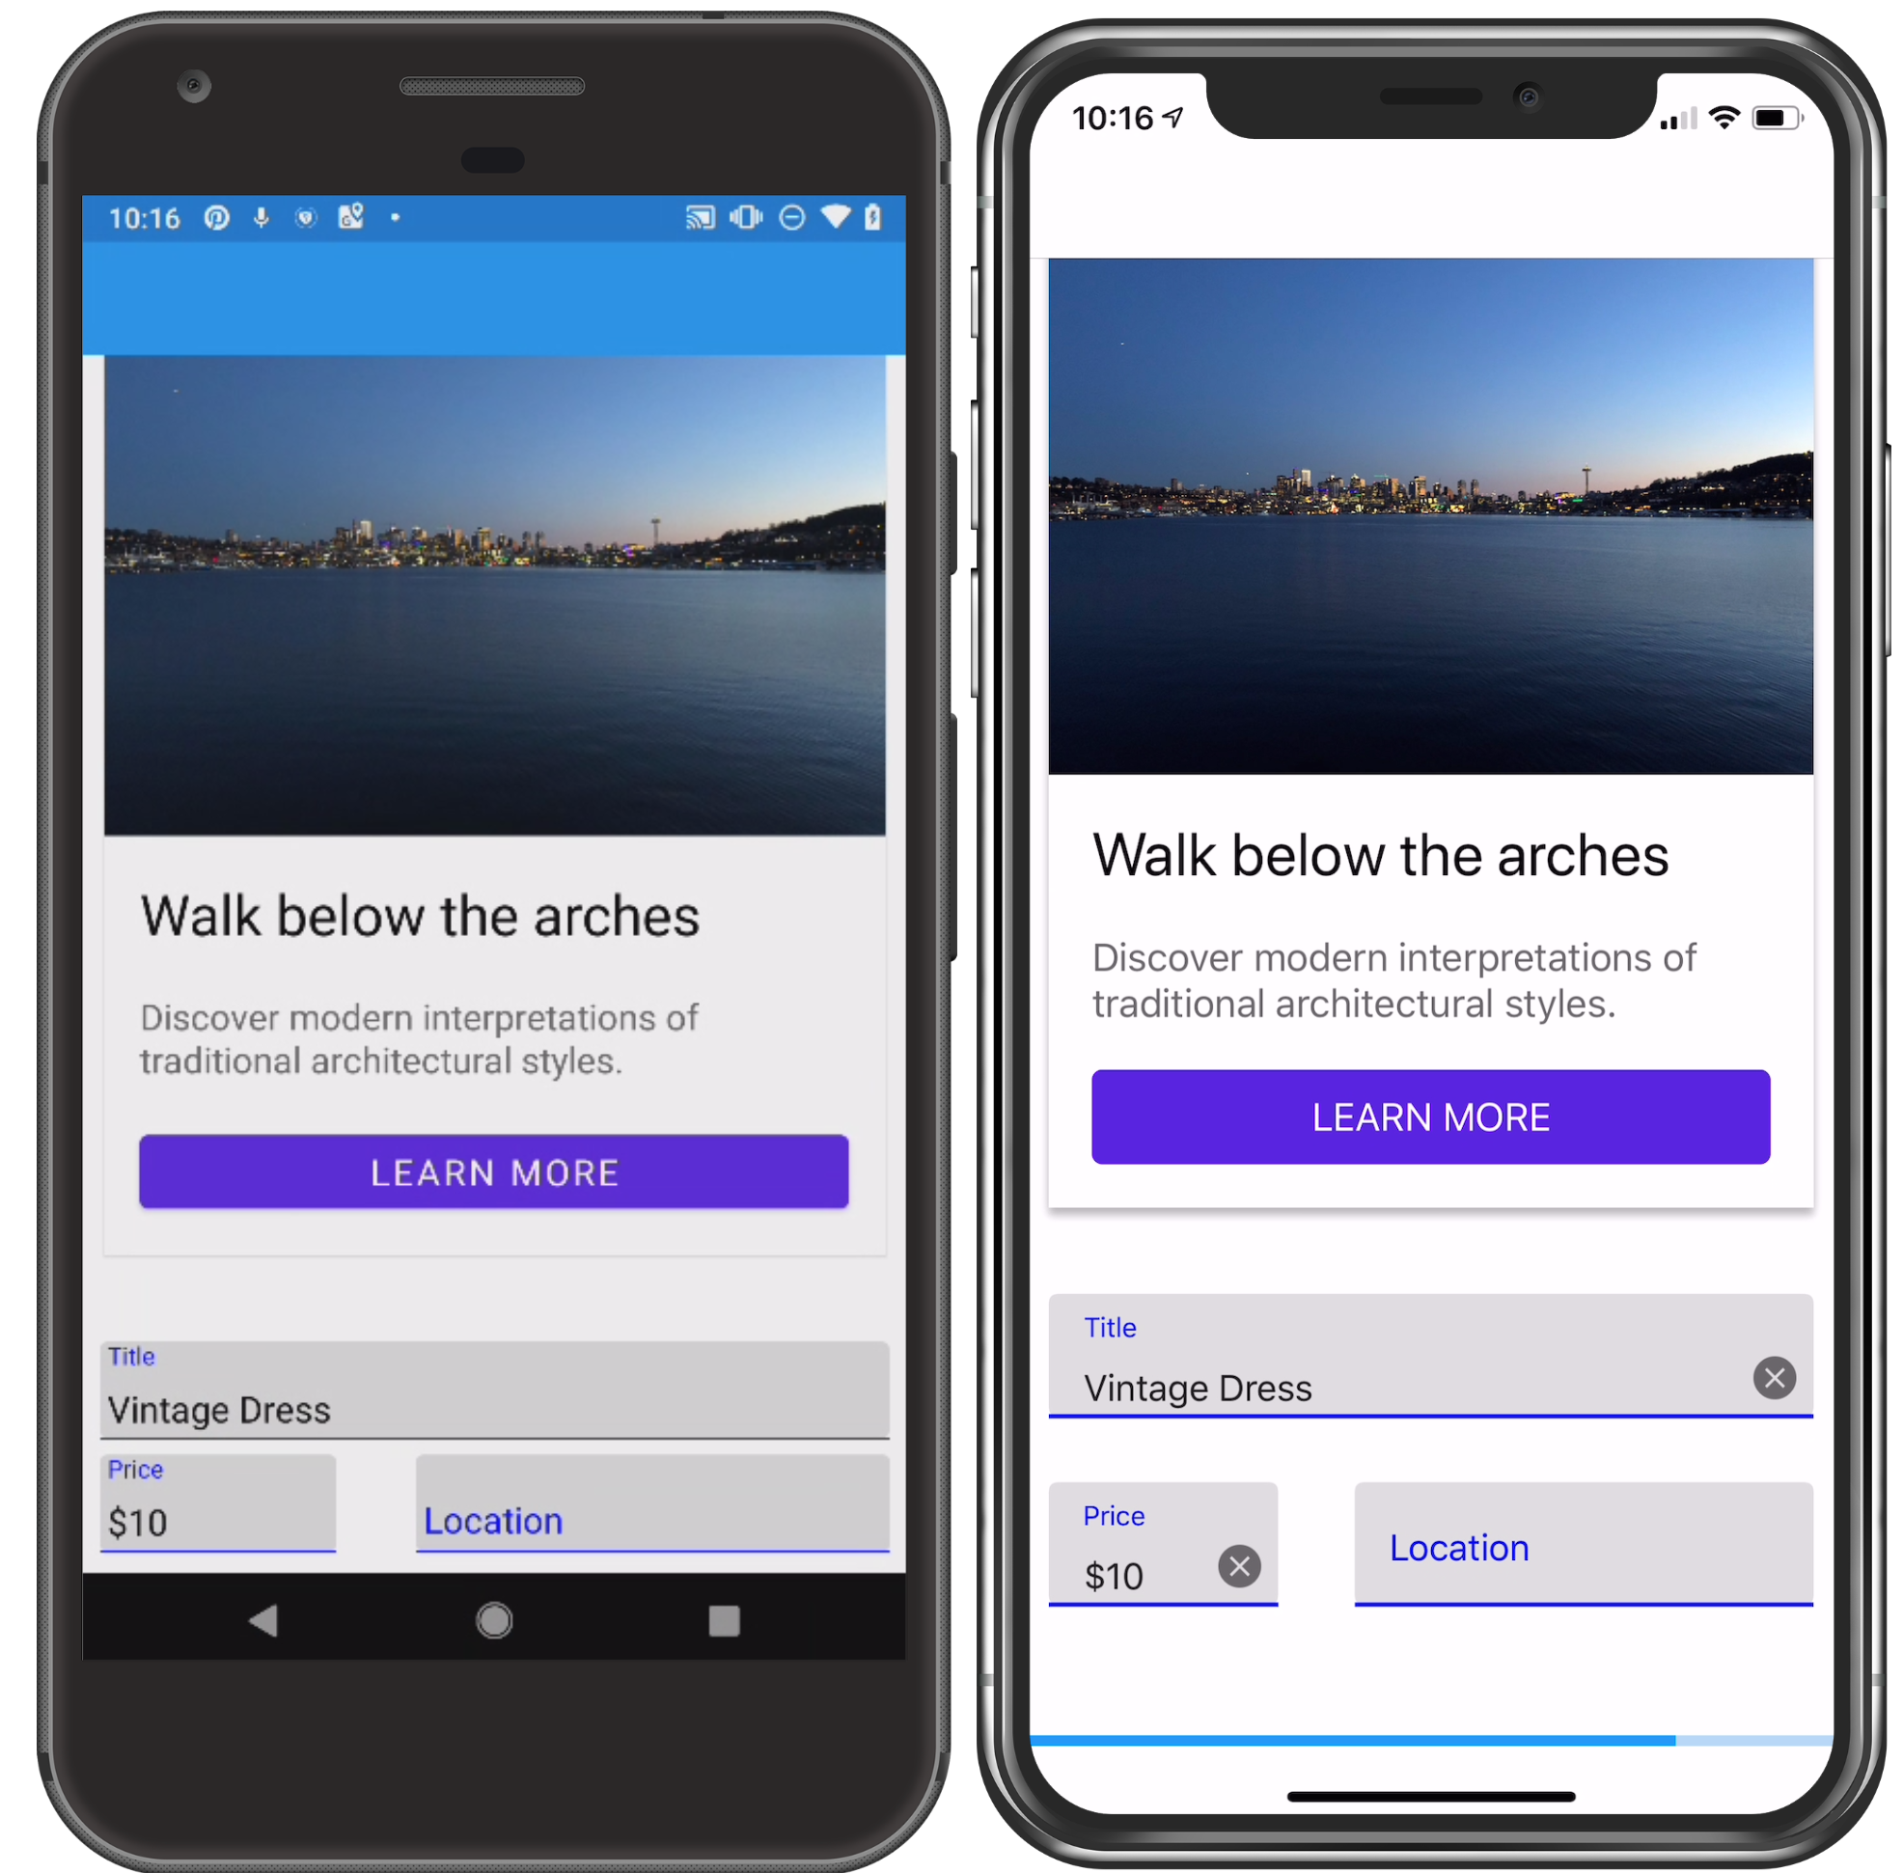
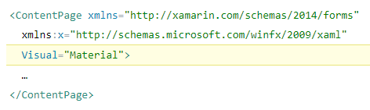
Consistent UI with Visual
Android 9.0
Android Support 28 latest version
Notes:
When it comes to the look of your mobile applications, you have told us that upwards of 90% of the time, you need iOS and Android to look mostly or exactly the same.

Slide 8
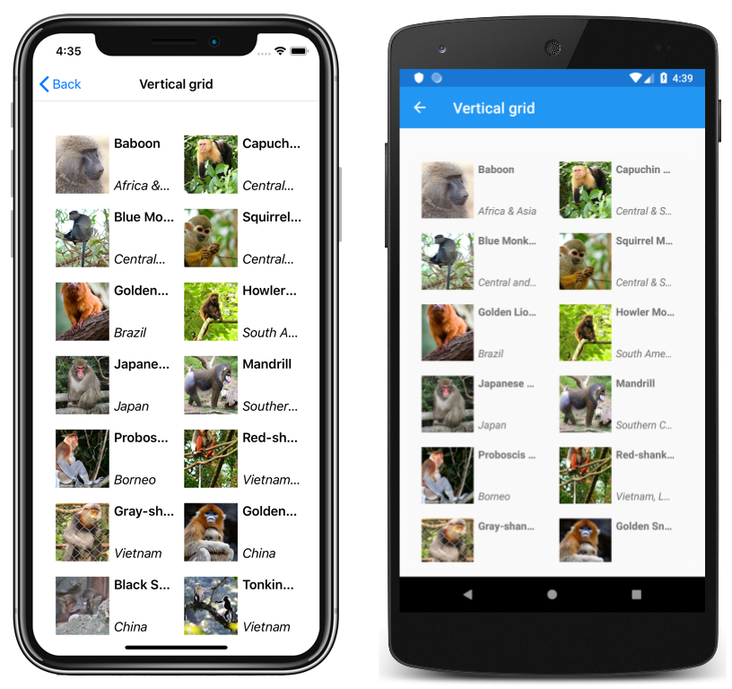
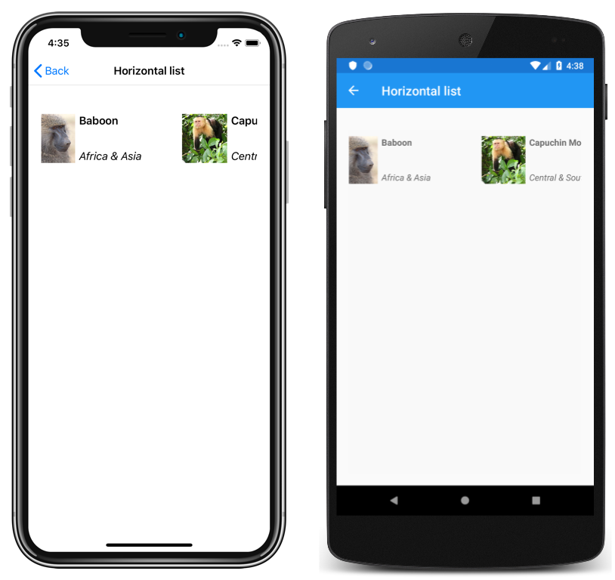
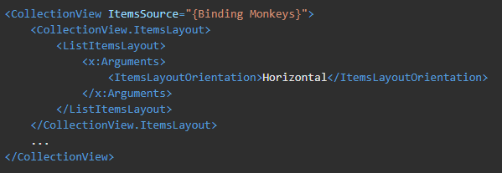
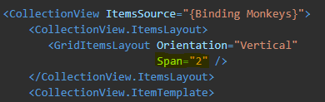
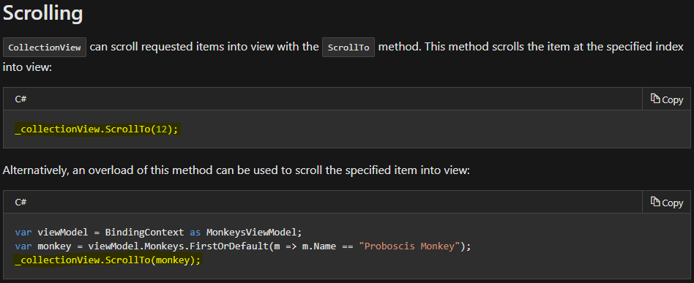
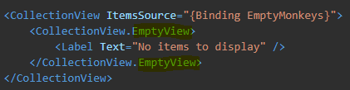
CollectionView
https://docs.microsoft.com/en-us/xamarin/xamarin-forms/user-interface/collectionview

Slide 9
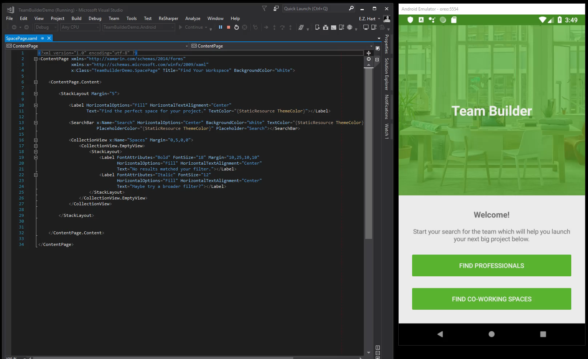

Slide 10

Cross-Platform Access to Platform Services
Xamarin.Essentials 1.0 is now available!
https://docs.microsoft.com/en-us/xamarin/essentials/
Notes:
29

Slide 11
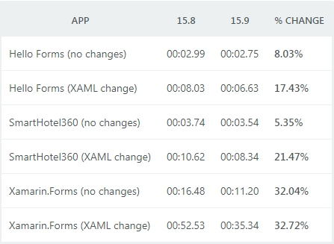
Android Build Performance & Reliability
Visual Studio 2017 version 15.9
Visual Studio for Mac 7.7
Hello Forms – A File | New | Xamarin.Forms project.
SmartHotel360 – A sample Xamarin.Forms application.
Xamarin.Forms Control Gallery – The control gallery.
https://blog.xamarin.com/android-build-performance-reliability/
https://blog.xamarin.com/multi-targeting-with-android-support-library-v28/
Notes:
Android Support Library v28 - multitargetting
Xamarin Android Designer Enhancements
Xamarin iOS Designer Enhancements
Android Emulator Improvements

Slide 12
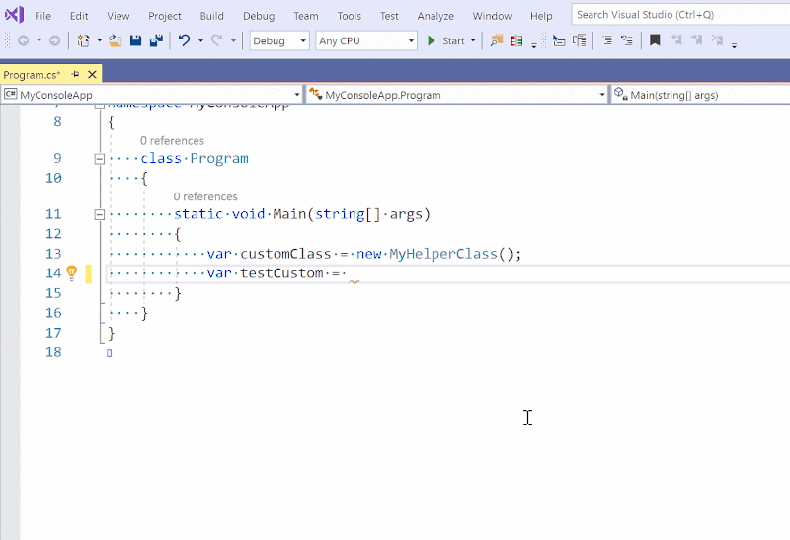
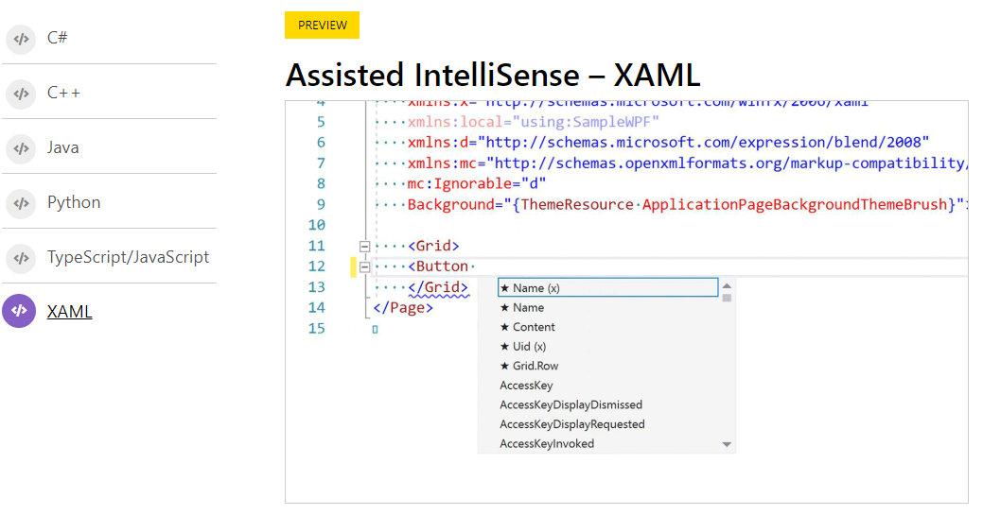
AI-Assisted XAML IntelliSense
https://visualstudio.microsoft.com/services/intellicode/
Notes:
29

Slide 13
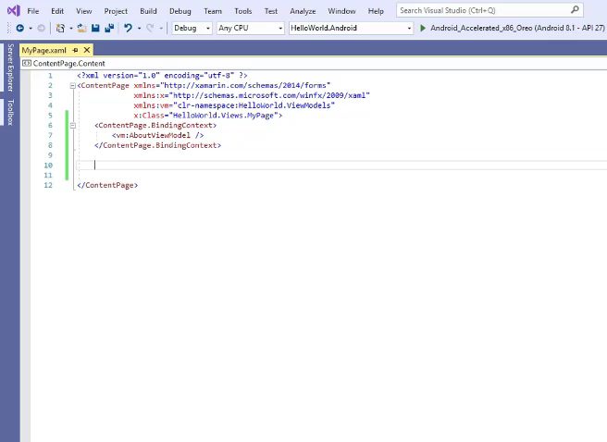
AI-Assisted XAML IntelliSense
Notes:
29

Slide 14
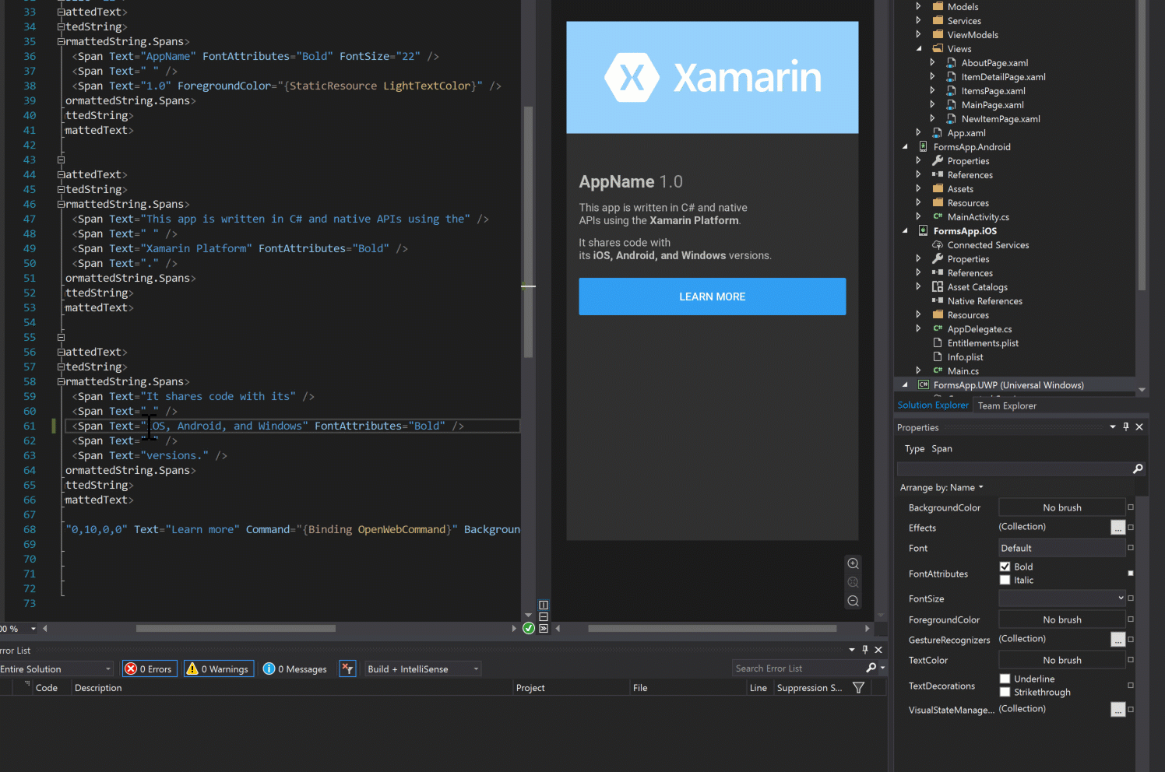
Xamarin.Forms Property Panel
Notes:
29

Slide 15
Teşekkürler ☺
http://teknolot.com
Yiğit Özaksüt
yigit@ozaksut.com
www.ozaksut.com

